Slide 1
following Jesus into our longings

Slide 6
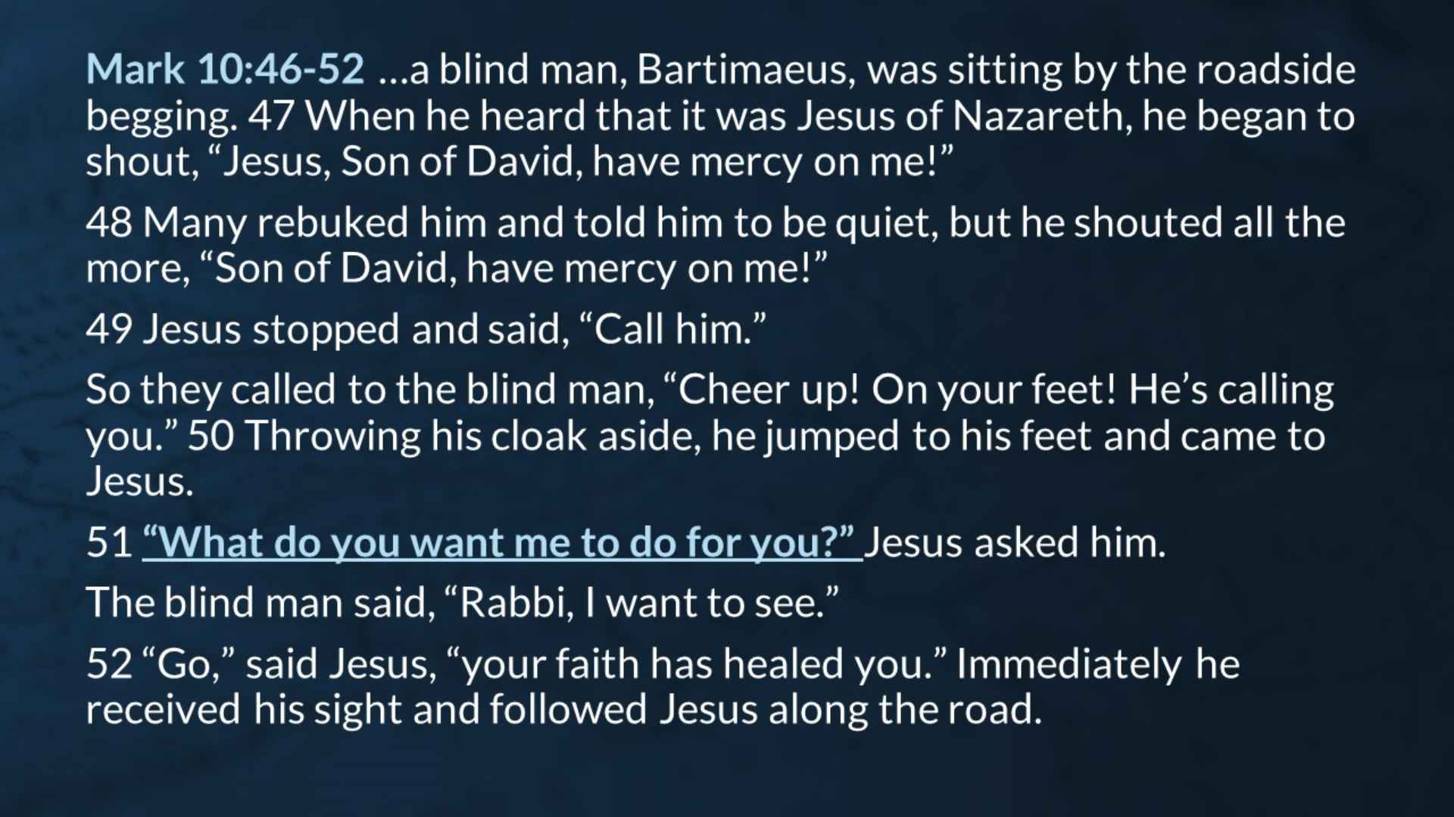

Slide 8
